Slide 1
Ethics in Computing
A Young Profession Coping with Ethical Debt

Slide 2
Theo Schlossnagle
@postwait
Founder CirconuS

Slide 3
DISCLAIMER
I am not an ethicist. This talk has more questions than answers.

Slide 4
ήθος -> ηθική
The philosophy of ethics is about systematizing, defending, and recommending concepts of right and wrong conduct.
Normative Ethics can be viewed from three lenses
Virtue Ethics
Deontology (Duties & Rules)
Consquentialism (Consequences)

Slide 5
Virtues
Perfect virtues vs. continence
Understanding the importance of practical wisdom

Slide 6
Change Over Time
Ethics exist only within the context of human society.
Human society changes
Globalization
Scientific understanding
Supernatural belief structures

Slide 7
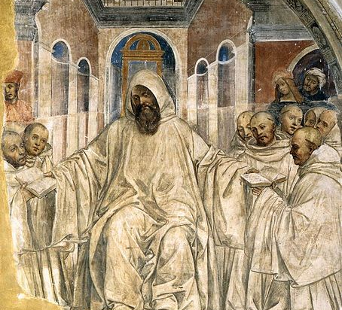
Applying Ethics
Clergy

Slide 8
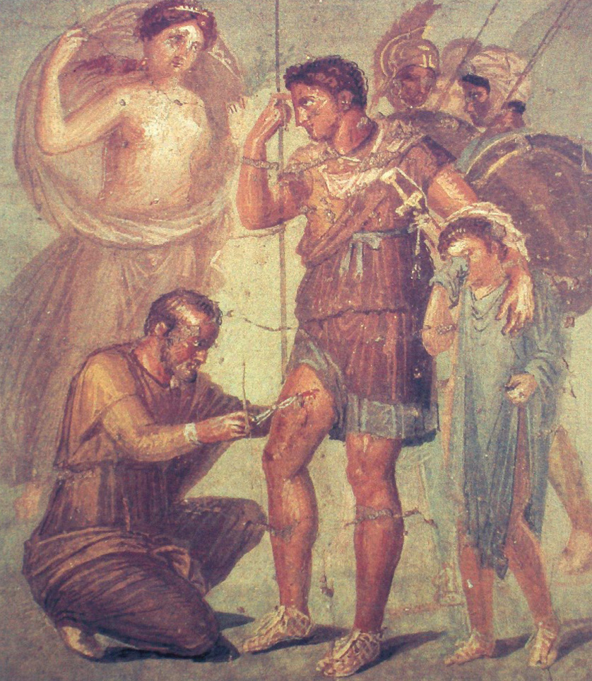
Applying Ethics
Clergy
Medical

Slide 9
Applying Ethics
Clergy
Medical
Business
Professional
Computing

Slide 10
VW Emissions

Slide 11
Uber Greyball

Slide 12
Uber Autonomous Vehicle Operation

Slide 13
Strava Global Heatmap

Slide 14
Technical Concepts Hand Soap Dispenser

Slide 15
Example of License Infringement

Slide 16
Antecdotes ~ What now?
What can we do?
From day to day ask, “what can I do?”
Is this really my responsibility?
Yes it &$%@*ing is.
Build more diverse teams.

Slide 17
Dissenting
Be aware that you are not alone
Understand that ethics are a spectrum
Keep records
Build a dispassionate defense
Work the system
Resigning

Slide 18
Start The Conversation
I don’t come with answers… I come with questions.
Familiarize yourself with a code of ethics for computing.
ACM’s Ethics policy (current 1992, new one expected 2018)
ACM’s “Ask and Ethicist”
We need to ask “what are the ethical implications?” all the time.

Slide 19
Notes
Virtue Ethics: https://plato.stanford.edu/entries/ethics-virtue/
ACM Code of Ethics http://ethics.acm.org/code-of-ethics/
ACM “Ask an Ethicist” http://ethics.acm.org/integrity-project/ask-an-ethicist-faq/
IEEE Dissention Guidelines http://ethics.iit.edu/ecodes/node/5707
Uber Greyball https://www.nytimes.com/2017/05/04/technology/uber-federal-inquiry-software-greyball.html
Uber’s Brazen Illegal Behavior https://www.theguardian.com/technology/2016/dec/16/uber-self-driving-cars-california-illegal-unethical-tactics
Soap https://gizmodo.com/why-cant-this-soap-dispenser-identify-dark-skin-1797931773
Volkswagen Emissions Scandal https://www.npr.org/tags/443453659/volkswagen-emissions-scandal
Strava Global Heatmap https://www.theguardian.com/world/2018/jan/28/fitness-tracking-app-gives-away-location-of-secret-us-army-bases

