Slide 1
PerfView Measure and Improve Your App’s Performance for Free
Sasha Goldshtein
CTO, Sela Group
@goldshtn

Slide 2
Performance metrics and simulations
Development-time profiling
Performance and load tests
Production-time performance investigations
Continuous low-overhead monitoring

Slide 3
One Production Performance Investigation
Customer pain point:
Very infrequently, user requests that save and load files are failing
“Detailed” performance monitoring report (1 day):
Average storage array latency is 5ms, so there’s no problem
“Super-detailed” performance monitoring report (3 days):
Per-minute average storage array latency numbers
Average of averages is 5ms, so there’s no problem

Slide 4
Use a Profiler

Slide 5
Problems with Traditional Profilers
Invasiveness
Overhead
Trace size
Licensing costs

Slide 6
Event Tracing for Windows (ETW)
High-performance logging framework with structured payloads and stack trace support
Used widely across Windows, .NET, drivers, services, and more

Slide 7
ETW Roles
Providers
Controllers
Log files
buffers
events
Event tracing session
real-time
logged events
events
Providers
Providers
Providers
Providers
Providers
Consumers

Slide 8
Some Interesting Providers
Kernel Sample (Profile) provider
Produces a call stack every 1ms of CPU execution time
CLR GC and SampAlloc provider
Produces events for garbage collections and object allocation samples
Kernel Context Switch provider
Produces events for context switches, enables tracking off- and on-CPU transitions (thread blocked time)
Kernel FileIO provider
Produces events for each file I/O operation and its duration

Slide 9
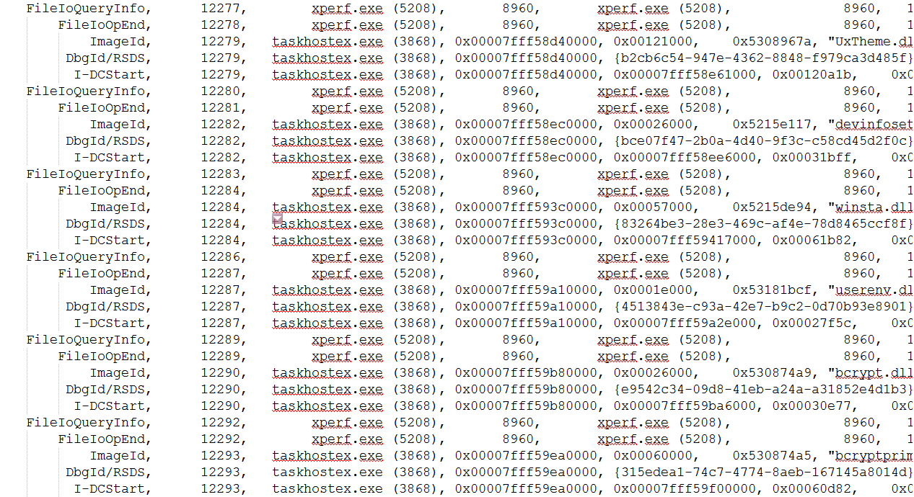
What’s In An ETW Recording?
A huge list of events, think millions
Events have multiple columns (payload), think Excel spreadsheet
Useless without additional processing

Slide 10
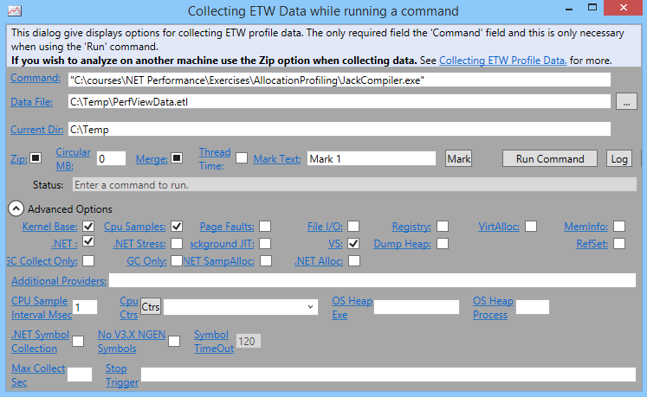
PerfView
ETW collection and analysis tool authored by Vance Morrison of the Microsoft .NET team
Huge variety of performance investigation scenarios
Steep(ish) learning curve
Watch training videos!

Slide 11
Demo: Using PerfView for CPU and blocked time investigations

Slide 12
Sidebar: It’s All In The Visualization

Slide 13
Demo: Using PerfView to investigate startup performance

Slide 14
Demo: Using PerfView to reduce memory allocations

Slide 15
Memory Analysis with PerfView
PerfView can capture optimized heap snapshots
Sampling, spanning tree generation, object content dropping
Compare snapshots to determine which objects are being allocated and not freed
Determine which GC root paths keep objects alive

Slide 16
Demo: Using PerfView to diagnose a memory leak

Slide 17
Summary
ETW is the performance monitoring framework of today and the future
PerfView is a free, universal analysis tool for CPU, memory, and thread time investigations
Detailed performance monitoring in production is possible and required

Slide 18
Thank You!
Sasha Goldshtein
@goldshtn

